Slide 1
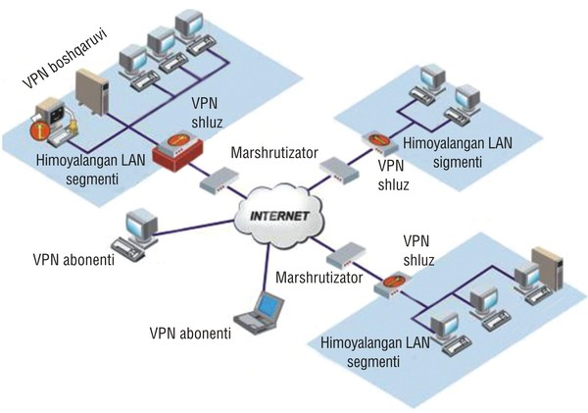
TARMOQ ADMINISTRATORLIGI 19-DARS

Slide 2
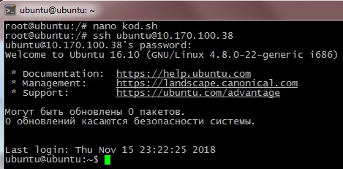
Masofadan serverni boshqarish
Masofadan turib linux serverdan linux serverga kirish
ssh usernomi@192.168.1.1 (agar ssh porti standart 22 bulsa port yozish shart emas)

Slide 3
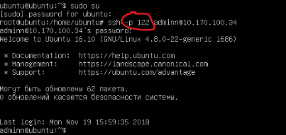
Masofadan serverni boshqarish
Masofadan turib linux serverdan linux serverga kirish
Agar ssh porti uzgargan bulsa quydagicha kiriladi serverga
ssh –p 122 usernomi@192.168.1.1
ssh ni portini o’zgartirish
nano /etc/ssh/sshd_config
Port 22

Slide 4
Copy ssh
Misol 1: Masofadagi serverdan lokal kompyuterga "file.txt" faylini nusxalash.
$ scp user@remote.host:file.txt /some/local/directory
Misol 2: Faylni "file.txt" faylini lokal kompyuterdan masofadagi serverga nusxalash.$ scp file.txt user@remote.host:/some/remote/directory
Misol 3:lokal kompyuterdan "dir1" jildini masofadagi serverga "dir2" katalogiga nusxalash
.$ scp -r dir1 user@remote.host:/some/remote/directory/dir2
Misol 4: Faylni "remote.host1" dan "remote.host2" boshqa masofadagi serverga "file.txt" faylini nusxalash.
$ scp user@remote.host1:/directory/file.txt user@remote.host2:/some/directory/

Slide 5
Misol 5: Fayllarni "file1.txt" va "file2.txt" fayllarini lokal kompyuterdan masofadagi serverdagi uy katalogingizga nusxalash.
$ scp file1.txt file2.txt user@remote.host:~
Misol 6:Faylni "file.txt" faylini lokal xostdan 2222-sonli port orqali masofaviy kompyuterga nusxalash.
$ scp -P 2222 file.txt user@remote.host:/some/remote/directory
Misol 7: Faylni "file.txt" faylini lokal kompyuterdan uzoq serverdagi uy katalogingizga nusxalash. O'zgarish va kirish vaqtini va kopyalagan fayl huquqlarini saqlaymiz.
$ scp -p file.txt user@remote.host:~
Misol 8: Faylni "file.txt" faylini lokal kompyuterdan uzoq serverdagi uy katalogingizga nusxalash. AES-128dan shifrlash algoritmini o'zgartirib, SCP tezligini oshirish (standart sifatida) Blowfish ga.
scp -c blowfish file.txt user@remote.host:~

Slide 6
Link yaratish va Arxivlash linux os da
Link yaratish
ln –s /papka ili filenomi /qayergaligi/
Misol: 1. touch index.php 2. ln –s /index.php /var/www/html
3. ls –al /var/www/html

Slide 7
Arxivlash
tar cvf nomi(arxivnomi).tar (arxivga olish kk bulgan papka ili file nomi)
tar cf nomi(arxivnomi).tar (arxivgaolishkk bulgan papka ili file nomi)
ARXIVDAN chiqarish
tar xvf nomi(arxivnomi).tar arxivdan chiqarish
Arxivlash
gzip nomi(arxivnomi).tar arxivga olish .gz
gunzip nomi(arxivnomi).tar.gz arxivdan chiqarish
du –sh razmerni bilish papka ili fayl

Slide 8
Arxivlash
bzip2 nomi(arxivnomi).tar .tar.bz2
bunzip2 nomi(arxivnomi).tar.bz2 arxivdan chiqarish
xz nomi(arxivnomi).tar .tar.xz
unxz nomi(arxivnomi).tar.xz arxivdan chiqarish

Slide 9
Group yaratish
Tar cf mytar.tar papka
Tar xf mytar .tar
Gzip /bzip2 /xz
Gunzip /bunzip2 /unxz
Tar cvzf aa.bz2
Tar xvf aa.bz2
Tar tf aa.bz2 kurish
Zip –r myzip.zip papka
Unzip myzip.zip chiqarish

